Slide 1
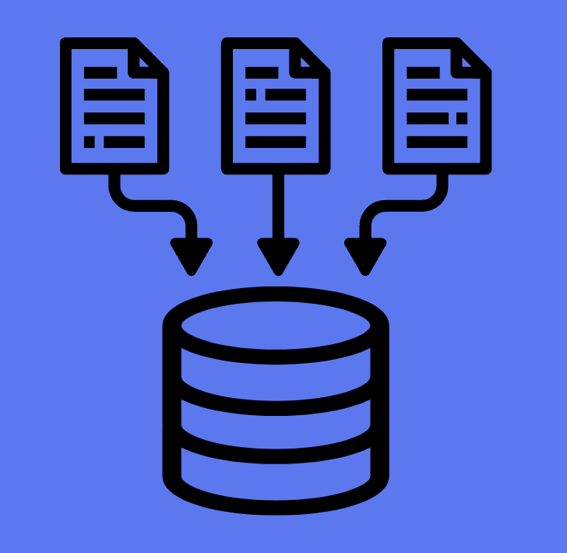
MODULE 1:
Database Fundamentals
MySQL

Slide 2
Database Fundamentals
What is a Database?
DBMS vs RDBMS
Why MySQL for Web Applications?
Client–Server Architecture
MySQL vs PostgreSQL (high-level comparison)
Hands-on
Installing MySQL (Linux/Windows)
MySQL Workbench & MySQL Command Line Interface (CLI)
Connecting to MySQL Server

Slide 3



What is a Database?
Simple Definition
A database is an organized collection of data stored electronically so it can be easily accessed, managed, and updated.
Real-World Examples
Instagram → User profiles, posts, comments
Amazon → Products, orders, payments
Banking system → Accounts, transactions

Slide 4
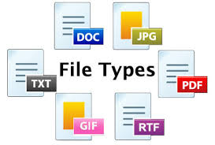

Without databases:
Data would be stored in files
Difficult to search
No relationships
High data duplication
No security

Slide 5
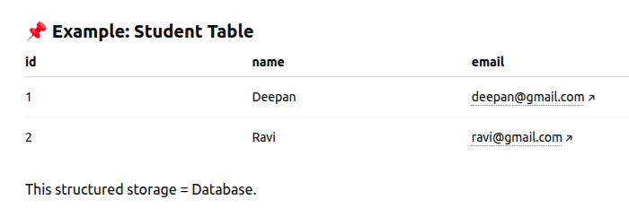

Slide 6
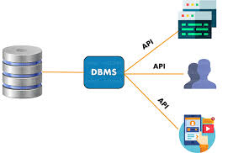
DBMS vs RDBMS
What is DBMS?
DBMS (Database Management System) Software that manages databases.
Examples:
Microsoft Access
MongoDB
Characteristics:
Stores data
No strict relationships required
May store unstructured data

Slide 7
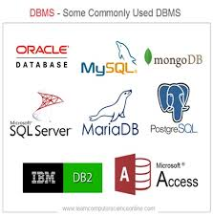
What is RDBMS?
RDBMS (Relational Database Management System)
Stores data in tables with relationships.
Examples:
MySQL
PostgreSQL
Oracle Database

Slide 8
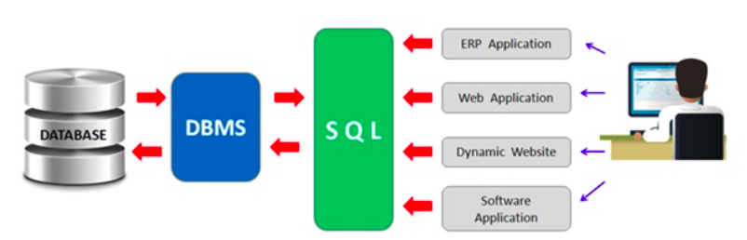
Database work flow

Slide 9
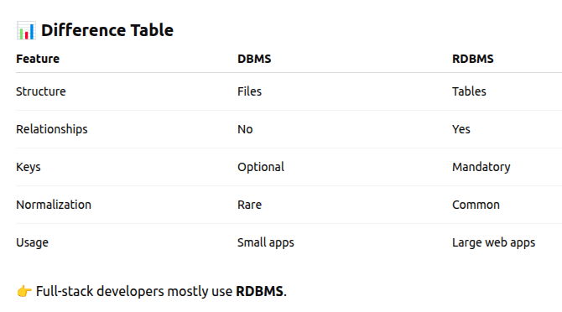

Slide 10


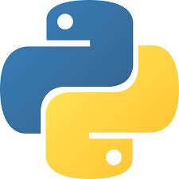

Why MySQL for Web Applications?
Reasons MySQL is Popular
1. Open Source
Free and widely supported.
2. High Performance
Optimized for read-heavy web applications.
3. Easy Integration
Works smoothly with:
Python
Django
Flask
Node.js
PHP

Slide 11
Why MySQL for Web Applications?
4. Large Community Support
Documentation, StackOverflow, tutorials available.
5. Used in Real Systems
Used in many large platforms.

Slide 12

Why MySQL for Python Full-Stack?
Because:
Django default support
Simple setup
Lightweight
Production ready

Slide 13
What is Client–Server Architecture?
Client–Server Architecture is a system design where:
The client sends requests
The server processes those requests
The server sends back a response
👉 In simple words: Client asks → Server responds

Slide 14
Real-World Example
When you open Amazon:
You open browser
You search for a product
Browser sends request
Server processes request
Server returns product list
That is client–server architecture.

Slide 15
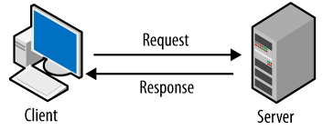
Client–Server Architecture
What is Client–Server?
A database system works in client-server model.
Structure:
Client (Application) ↓ MySQL Server ↓ Database

Slide 16
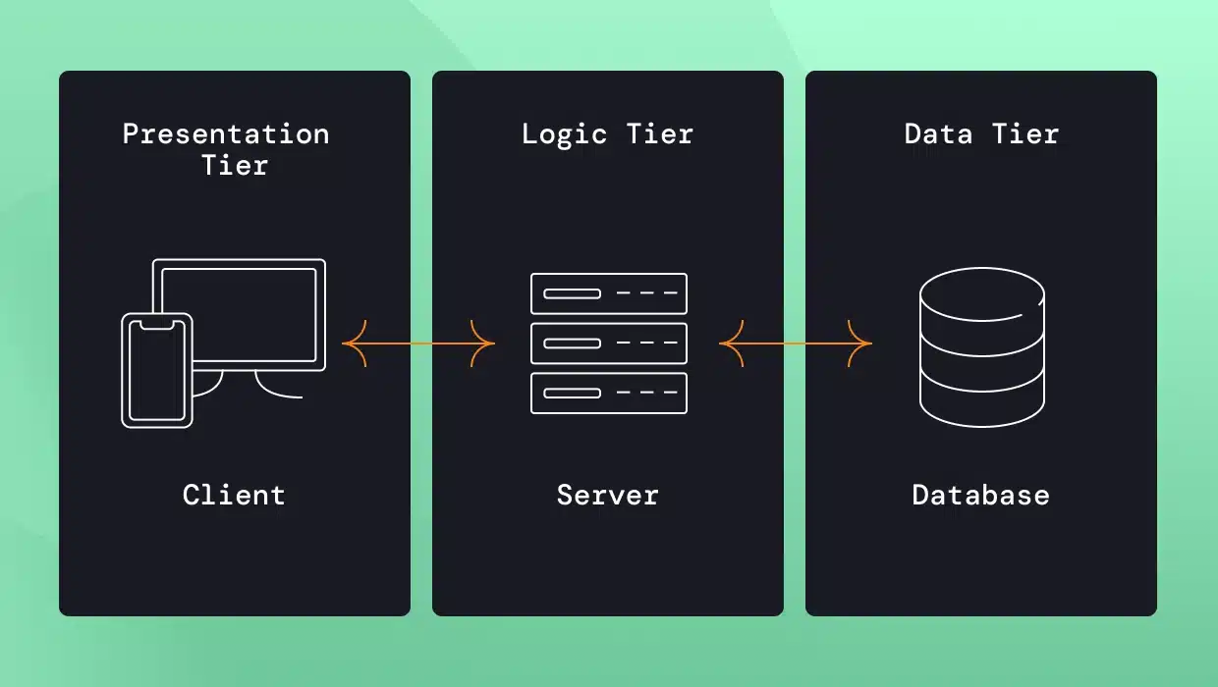
Client–Server Architecture

Slide 17
Client
The client is the system that initiates the request.
Examples:
Web Browser (Chrome)
Mobile App
Python Application
phpMyAdmin
Client does:
Send requests
Display results
Handle UI

Slide 18
Server
The server:
Receives requests
Processes logic
Accesses database
Sends response
Example:
MySQL Server
Django server
Flask server

Slide 19
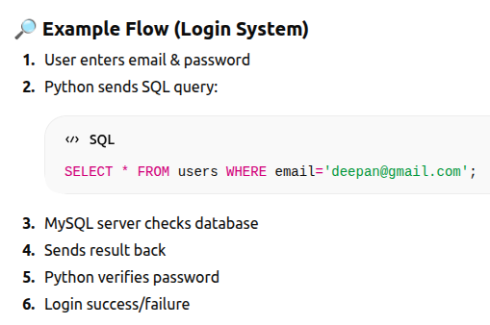

Slide 20
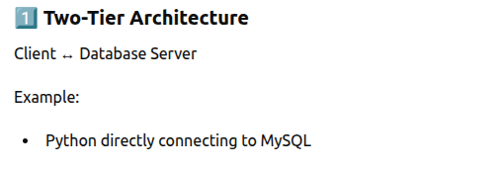
Types of Client–Server Architecture

Slide 21
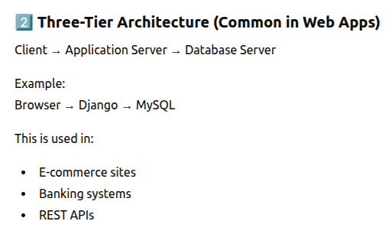
Types of Client–Server Architecture

Slide 22
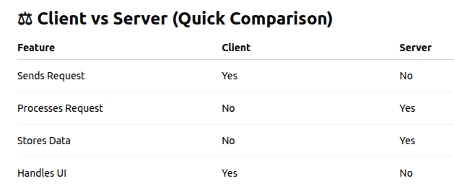

Slide 23
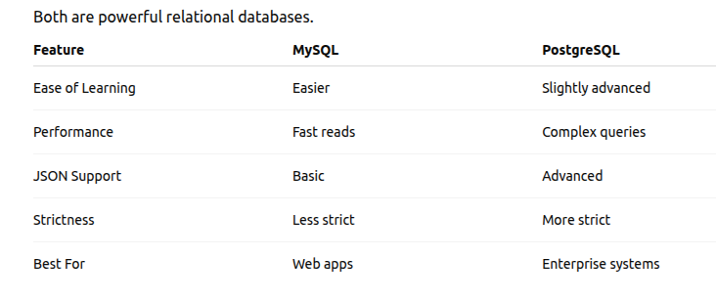
MySQL vs PostgreSQL (High-Level Comparison)

Slide 24
MySQL vs PostgreSQL
👉 If building:
E-commerce
Blogs
REST APIs → MySQL is perfect
👉 If building:
Financial systems
Analytics systems → PostgreSQL preferred

Slide 25
Hands-On Section (Practical Part)
Installing MySQL
Windows
Download from official website of MySQL
Choose MySQL Installer
Select:
MySQL Server
MySQL Workbench
phpmyadmin
Set root password

Slide 26
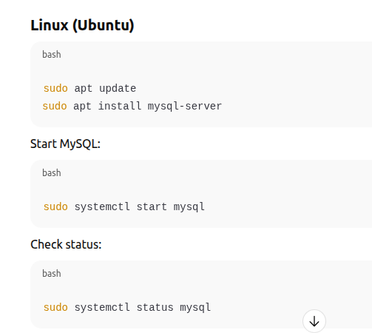

Slide 27
phpMyAdmin Interface Overview
http://localhost/phpmyadmin

Slide 28
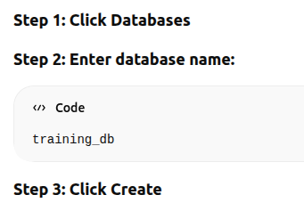
Creating Database Using phpMyAdmin

Slide 29
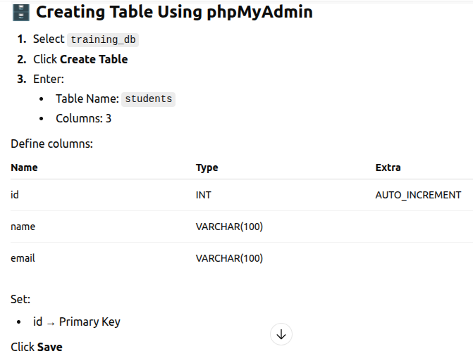

Slide 30
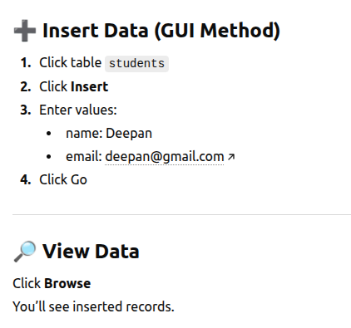

Slide 31
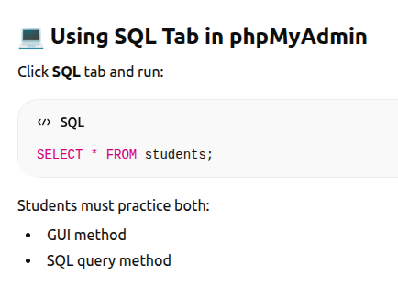

Slide 32
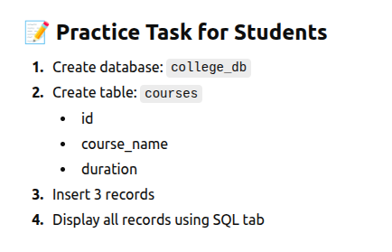

Slide 33
Session End

